Slide 1
MODERN IOT: THE JOURNEY FROM REACTIVE TO PREDICTIVE PART 2
Ciprian Jichici
Jitendra Shirolkar
JOEL HULEN

Slide 2
Enters Machine Learning to augment the value of the IoT solution
Today’s focus is on anomaly detection
Progressing gradually from simple solution to complex approach based on Azure Machine Learning

Slide 3
09:00 AM – 10:00 AM : Intro and environment setup
10:00 AM – 11:00 AM : Lab 1
11:00 AM – 11:15 AM : Lab 2 intro
11:15 AM – 12:00 PM : Lab 2
12:00 PM – 01:00 PM : Lunch break (The Marquee Ballroom)
01:00 PM – 01:45 PM : Lab 2 (continued)
01:45 PM – 02:00 PM : Lab 3 intro
02:00 PM – 04:00 PM : Lab 3

Slide 4
The data sets – measurements of temperature, humidity, and water level
Normal
Gradual
Sudden

Slide 5
Lab 1 – Simple anomaly detection
Lab 2 – Detecting geographical anomalies
Lab 3 – Model deployment and real-time scoring

Slide 6
All materials available in the Day2 folder at
https://github.com/solliancenet/IoTLabs

Slide 7
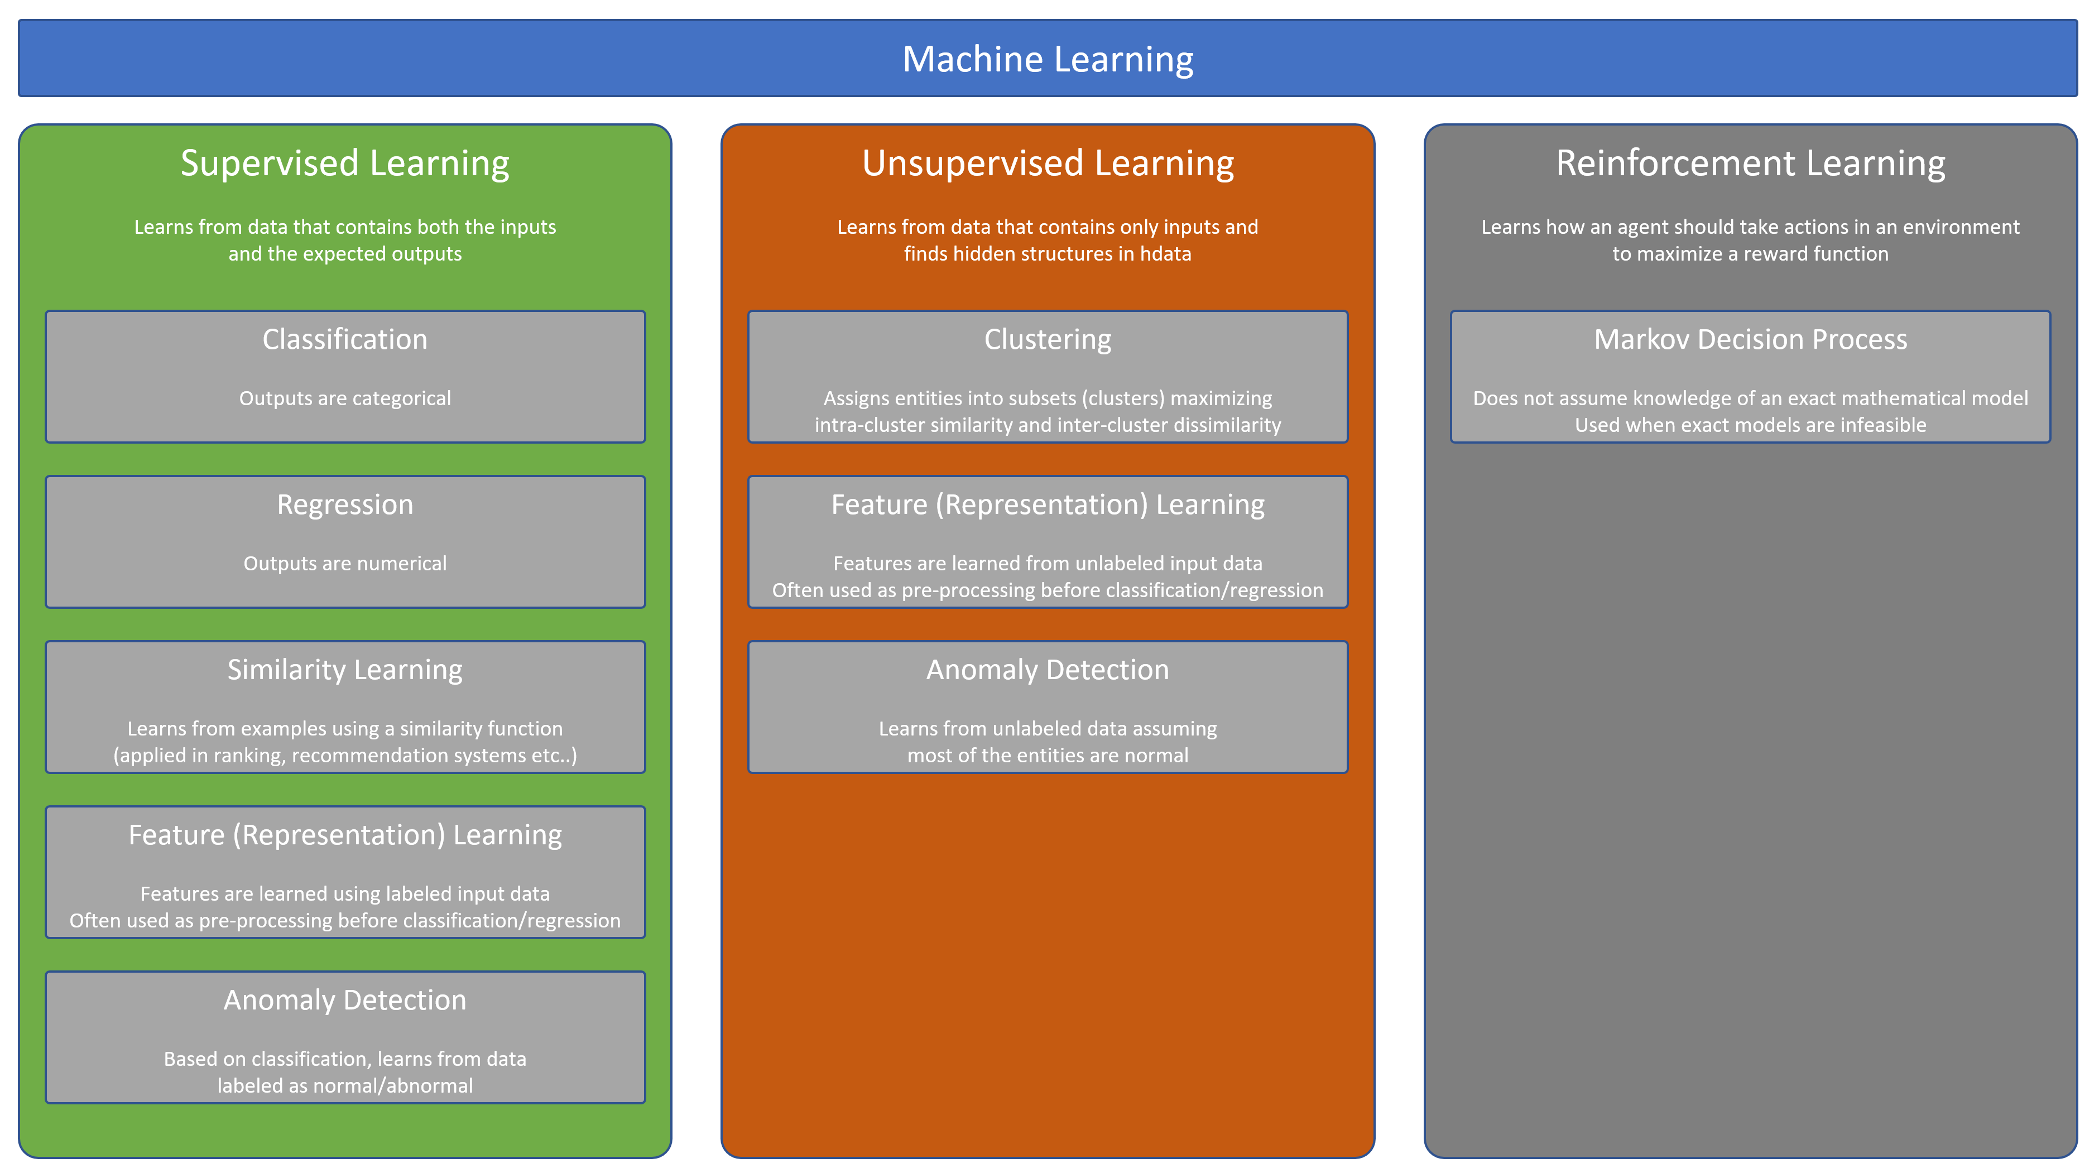

Slide 8
The difficult problem of anomaly detection
All cases
Anomalies

Slide 9
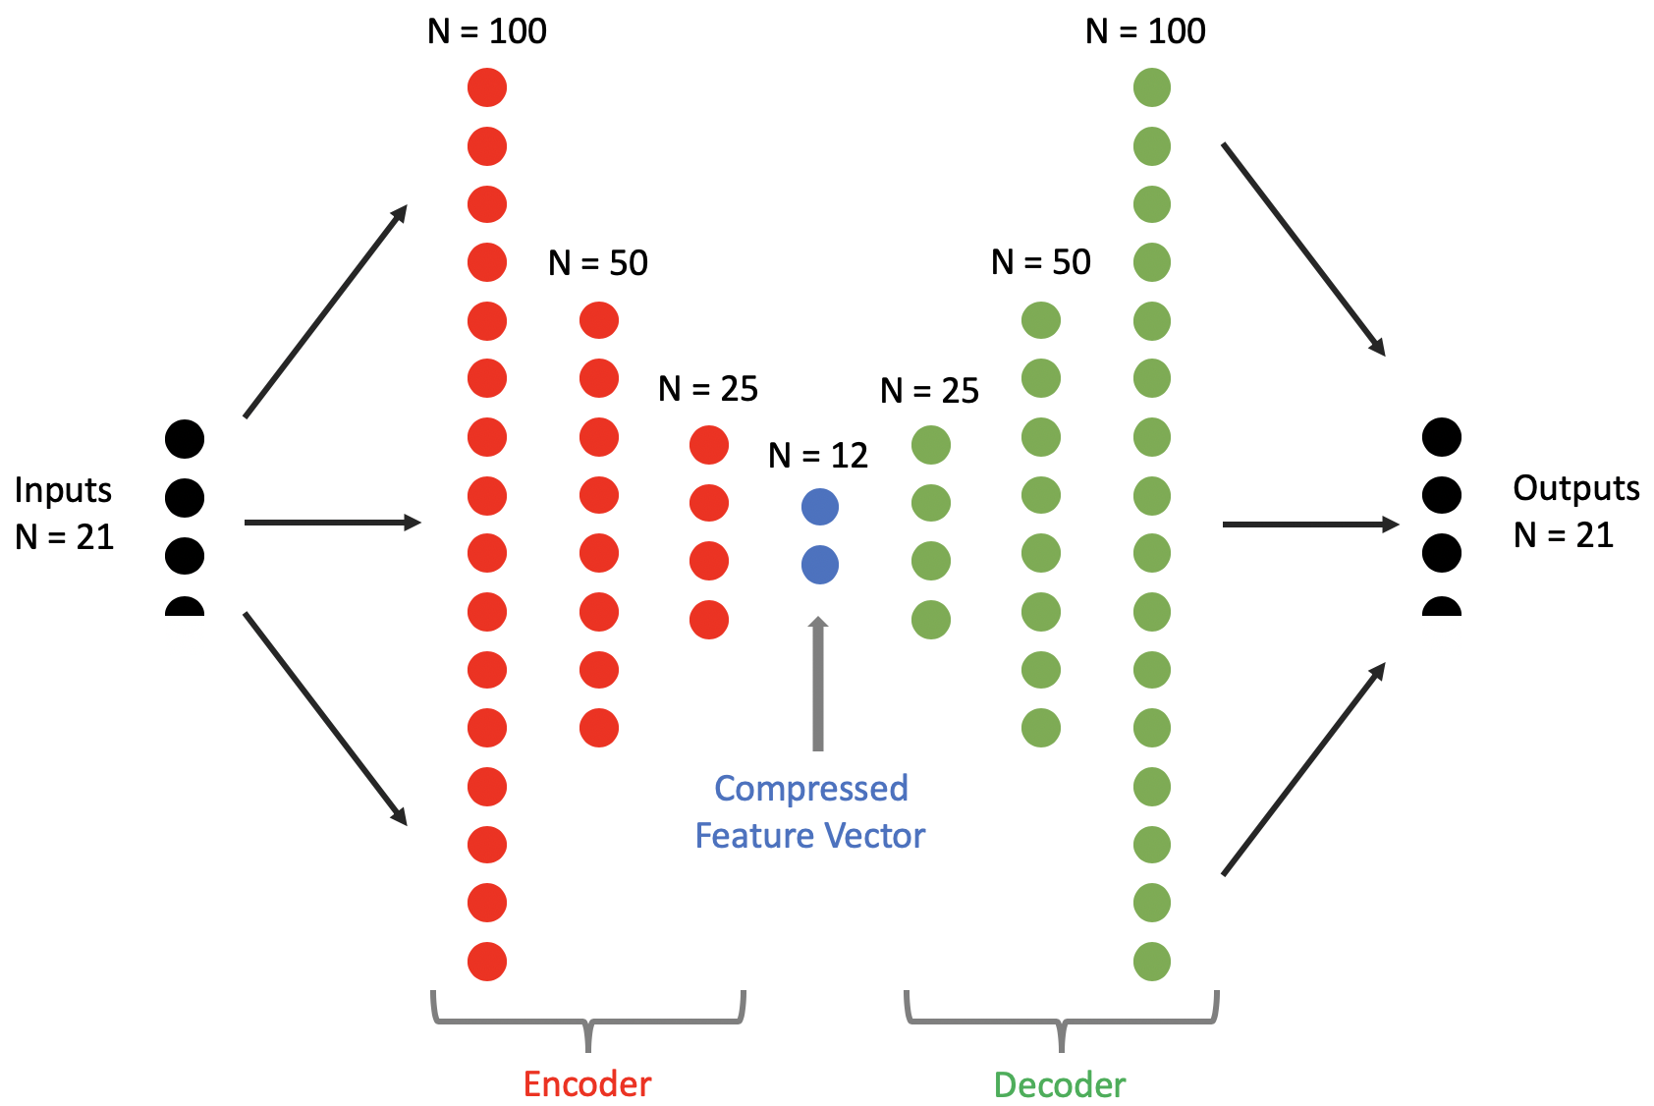
Using a deep learning autoencoder for anomaly detection

Slide 10
The principles:
The autoencoder is trained on ‘normal’ data – we’re instructing it to recognize normal conditions
This yields a level of loss that is established as a threshold for anomaly detection
When new data comes in, the autoencoder attempts to score it, resulting in a certain loss level
If the loss level is above the threshold, an anomaly is being detected

Slide 12
LAB 0: SETTING UP THE ENVIRONMENT

Slide 13
LAB 1: Simple ANOMALY DETECTION

Slide 14
LAB 2: Detecting Geographical Anomalies

Slide 15
Polk County, Iowa
92 Sensor locations
Water Level – Depth to water level in feet below the land
Temperature
Humidity
3 Years 2017-2019
Daily data collection – 100,740 data observations
Detect localized anomalies
Part I: Define proximity based clusters of sensors
Part II: Anomaly Detection
Model features
Autoencoder model architecture
Model training
Establish criteria for anomalies

Slide 16
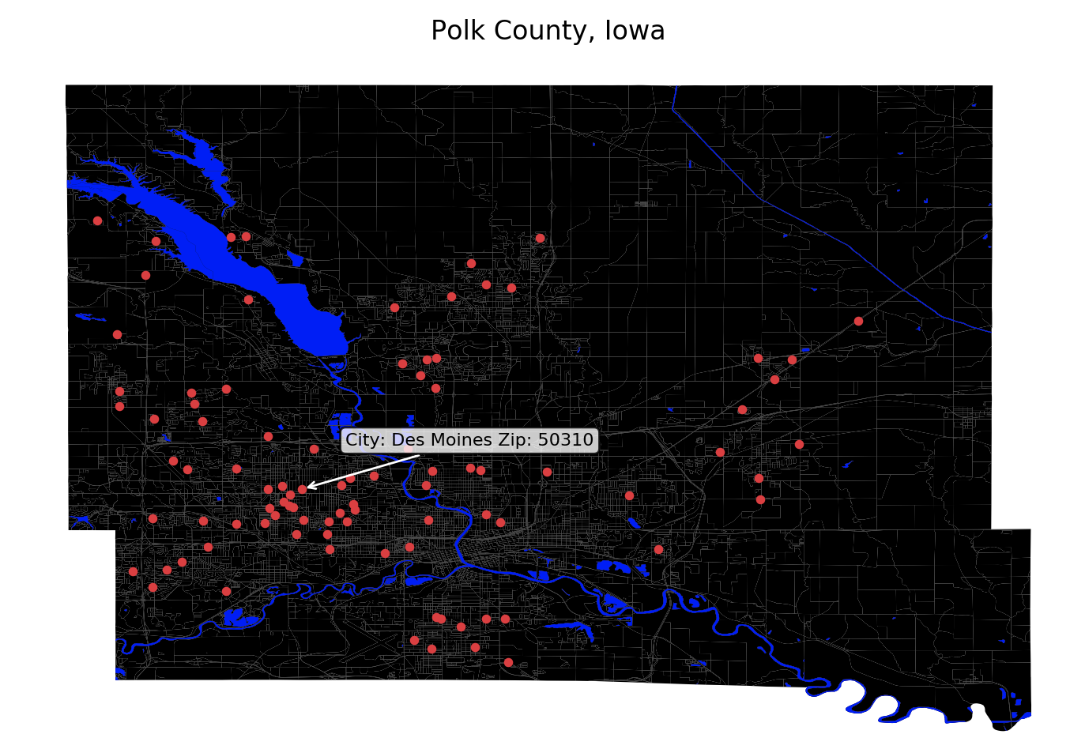

Slide 17
Part I: Proximity Based clusters
Identify 6 proximity based clusters
Features: Latitude and Longitude
K-Means Clustering Algorithm – Unsupervised distance based algorithm
Provide cluster labels
Cluster membership will be used as a new feature in model training

Slide 18
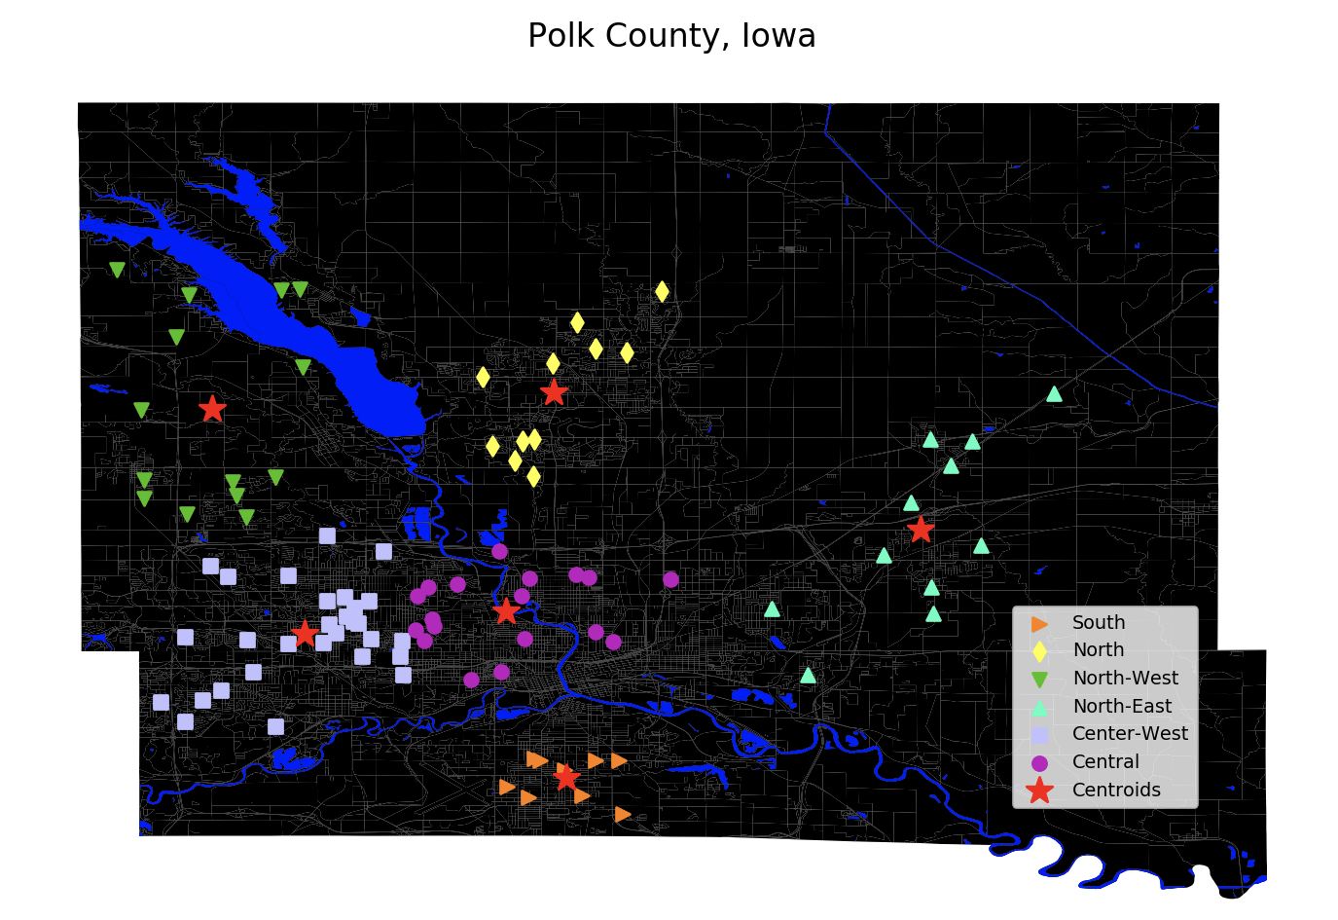

Slide 19
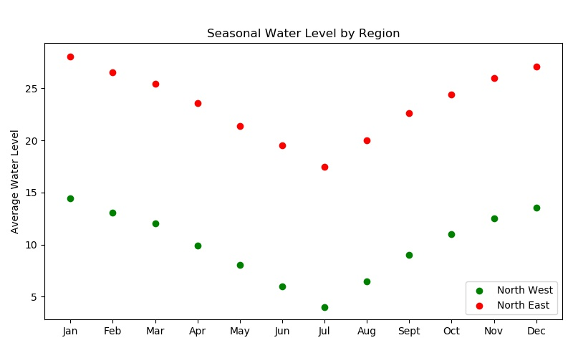
The graph shows the normal seasonal patterns for two different regions.
The North West Region is close to a water body and tends to be wetter compared to the North East Region.

Slide 20
Part ii: Anomaly detection
The goal is to develop an approach to monitor a group of sensors based on their proximity to each other to predict regional anomalies in real-time.
A gradual build up dry conditions in one of the regions in Polk County, Iowa over the months of June and July 2019.
Train on local compute with a subset of the full dataset.

Slide 21
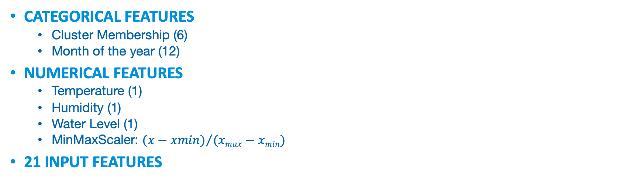
Model Input features
Categorical features
Cluster Membership (6)
Month of the year (12)
Numerical features
Temperature (1)
Humidity (1)
Water Level (1)
MinMaxScaler: ${(x−xmin)}/{(xmax−xmin)}$
21 input features

Slide 22
Model architecture

Slide 23
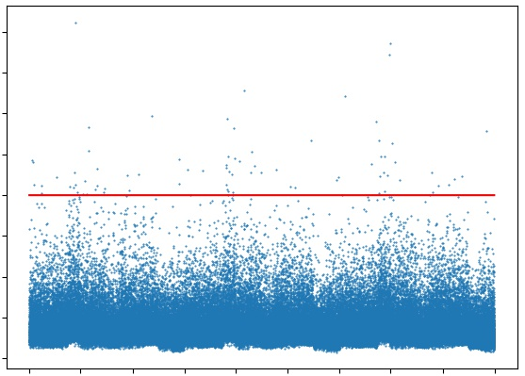
Model training
Reconstruction Error
Goal: Reduce the validation loss so that the reconstruction error for normal data is in a tight band.

Slide 24
Model training - hyperparameter tuning
Leverage keras.callbacks.LearningRateScheduler to steadily decrease the learning rate as the training progress to drive down the validation loss.
Define a function to schedule
the learning rate
def schedule(epoch_number, current_lr):
if (epoch_number < 25):
lr = 0.001
…
return lr
lr_sch = keras.callbacks.LearningRateScheduler(schedule, verbose=1)
history = model.fit(…, callbacks=[lr_sch])
1
2
Create the LearningRateScheduler
and pass it the schedule function
3
Pass the LearningRateScheduler
in the callbacks list during model training

Slide 25
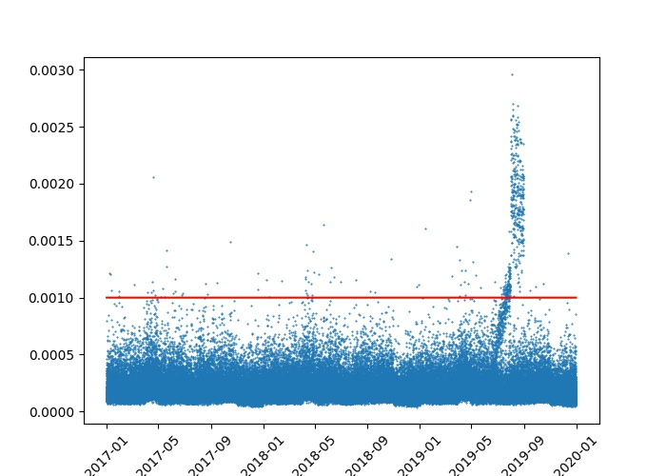
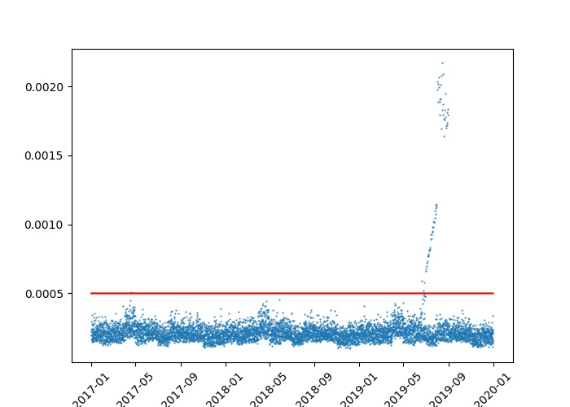
criteria for anomalies
Standard or point anomalies
The graph shows reconstruction error for individual sensors vs mean reconstruction error for clusters.
Mean reconstruction error computed for a cluster suppresses the noise from individual sensors and is shown to predict regional anomalies earlier than point anomalies by using a lower threshold.
Reconstruction Error
Cluster anomalies

Slide 26
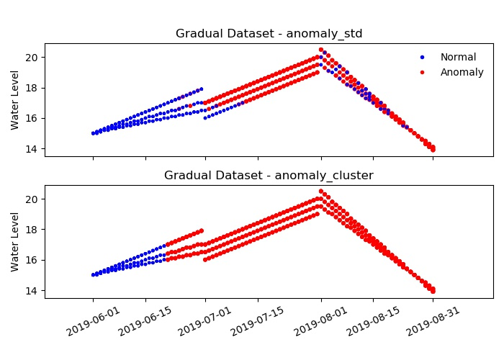
criteria for anomalies
The graph shows anomalies predicted using reconstruction error for individual sensors (anomaly_std) versus mean reconstruction error for a cluster (anomaly_cluster).
The anomaly_cluster criteria predicts the regional anomalies earlier than anomaly_std.

Slide 27
Lab 3: Deploying the model for real-time scoring
How to deploy the trained model to a webservice and use it in a real-time stream processing pipeline

Slide 28

Azure Machine Learning service
Simplified machine learning
End to end lifecycle management
Open platform

Slide 29
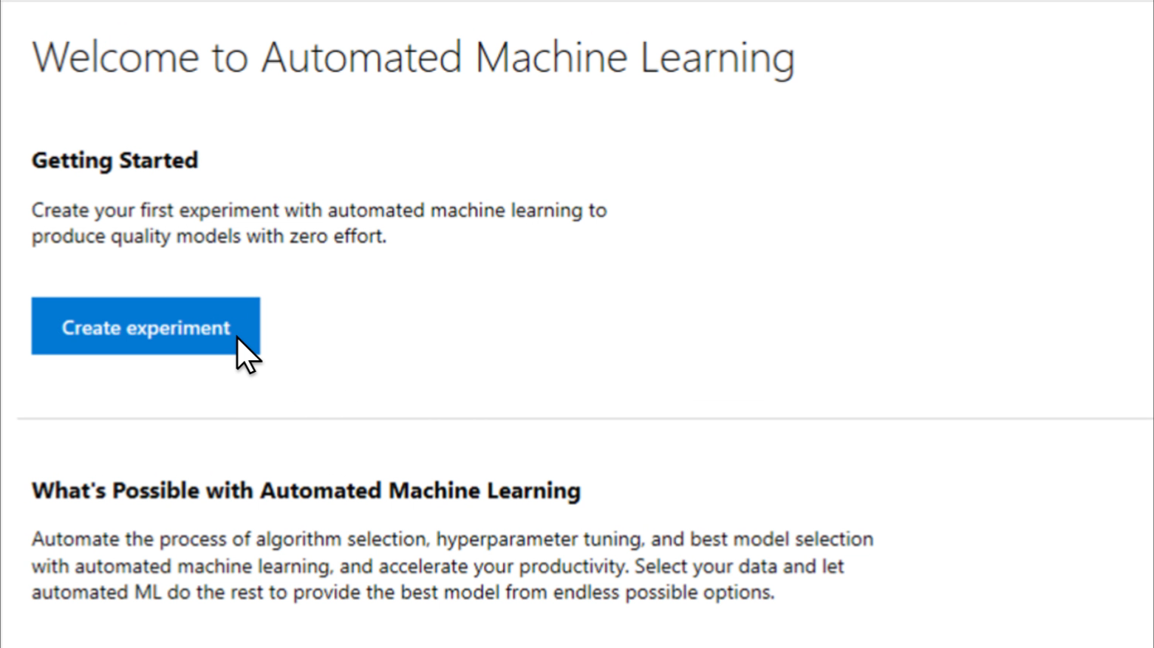
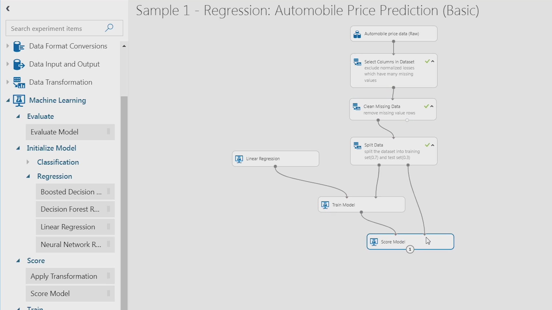
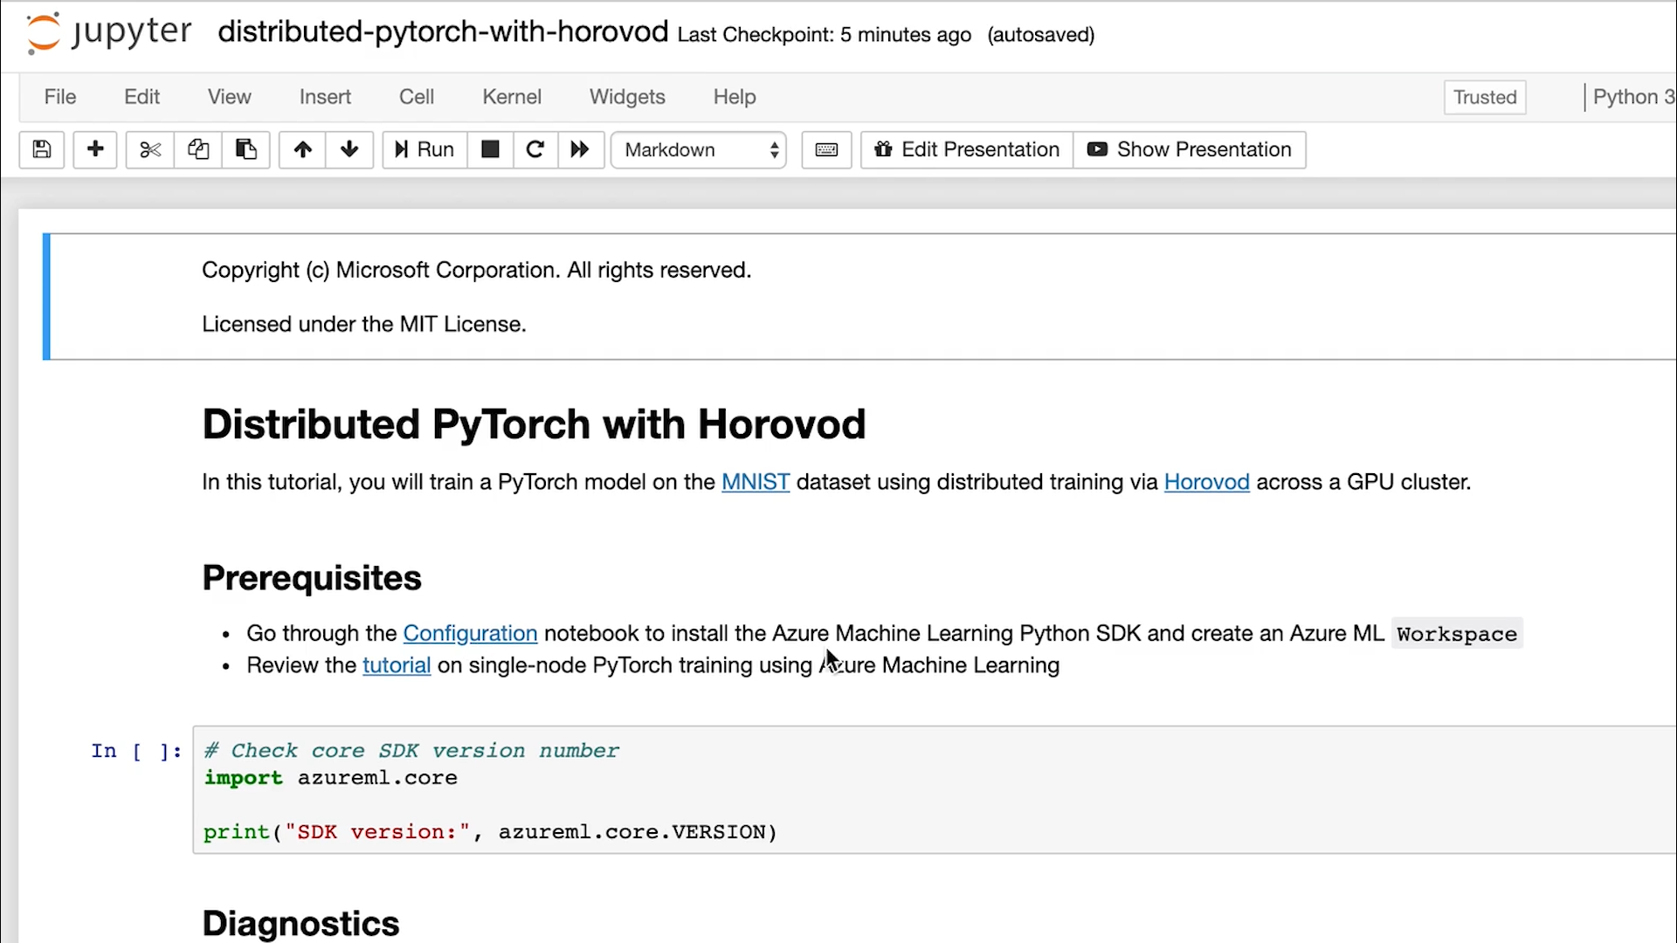
Simplify machine learning for any skill level
Automated machine learning UI
Visual interface
Machine learning notebooks

Slide 30
Deploying a trained model – the traditional way
Get the model file (any format)
Create a scoring script (.py)
Optionally create a schema file describing the web service input (.json)
Create a real-time scoring web service
Call the web service from your applications
Repeat the process each time you re-train the model

Slide 31



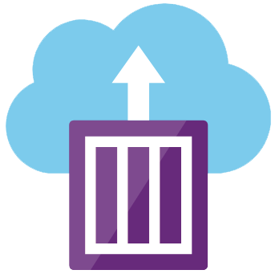
Deploying with Azure Machine Learning
Azure ML deploys containers to:
Azure Kubernetes Service – or – Azure Container Instance
Device Application
Serialized Model
Desktop Application
Serialized Model
Use the trained model to make predictions
Containerized Model
Trained Model
Web Server Application
Containerized Model
IoT Edge Device
Serialized Model
Containerized Model
Notes:
Use Azure Machine Learning to deploy a model as a web service on Azure Kubernetes Service (AKS). Azure Kubernetes Service is good for high-scale production deployments. Use Azure Kubernetes service if you need one or more of the following capabilities:
Fast response time.
Autoscaling of the deployed service.
Hardware acceleration options such as GPU and field-programmable gate arrays (FPGA).
Use Azure Container Instances if one of the following conditions is true:
You need to quickly deploy and validate your model. You do not need to create ACI containers ahead of time. They are created as part of the deployment process.
You are testing a model that is under development.

Slide 32


Deploy machine learning models at scale
Azure Machine Learning service
Build and Train Models
Train Models
Validate
Deploy Models
Monitor
Containerize and test on Azure Container Instance
Scale with Azure Kubernetes Service
Monitor models with Azure ML
Automated ML
Azure ML Compute
Azure DevOps integration
CI/CD and model retraining

Slide 33


Process streams using serverless
Azure Functions
Stream Analytics
Stream Analytics on IoT Edge
Uses EventProcessorHost to read data in near real-time from Event Hubs/IoT Hub Good for enriching streaming data where velocity around 100,000 events/second or less
C#, F#, Java, Node, Python, PowerShell
High volume event-processing engine using SQL-like language
Output to multiple data sinks such as Service Bus, Power BI, Cosmos DB, Event Hubs, SQL Database
SQL, C#/JavaScript UDFs
Uses same query language on both cloud and edge
Deploys to Docker container on IoT edge device
Good for filtering & aggregating data locally before sending to cloud

Slide 34
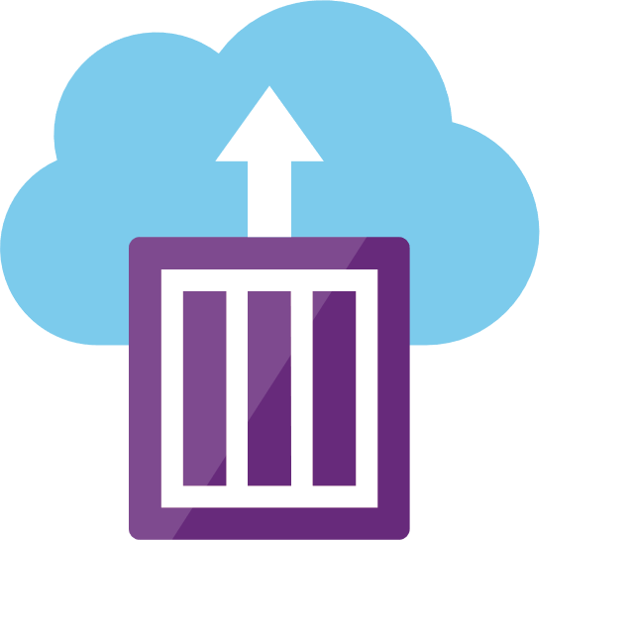




Azure Machine Learning
Azure Container Instance
Water Sensors
IoT Hub
App Insights
Admins
Azure Functions

